Slide 1
Our Neighborhood: University Heights

Slide 2
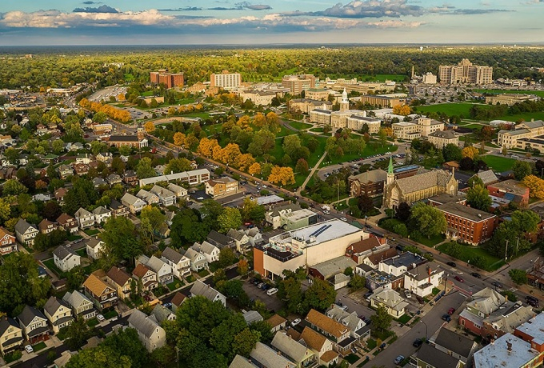
History
UB was founded in 1846, and the South Campus was established in 1909, meaning that UB has been part of this community for over 100 years.

Slide 3
Quick Facts
The University District has 37,000 people, making up 14% of the population of the City of Buffalo
Over 50% of the houses are owner-occupied homes
More than half of the residents have lived there for over 10 years
24% of residents are under 18 and 11% are over 65
Property crimes in the district has dropped 17% in recent years

Slide 4
Neighborhood Assets

Slide 5
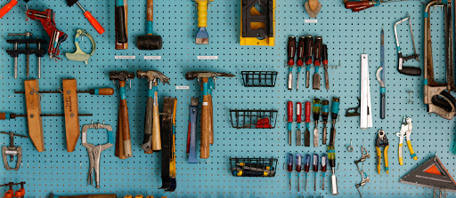
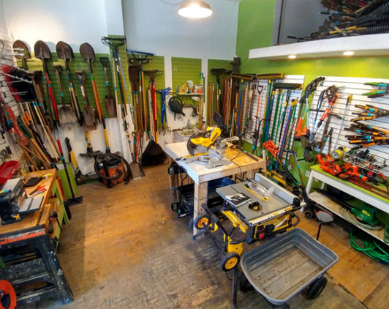

The Tool Library
Located at 5 West Northrup, The Tool Library is a neighborhood non-profit focused on providing tools at low costs to all of Western New York.
The Tool Library also conducts service days to keep the neighborhood and its parks looking great!
Students can become members of the Tool Library for $20 a year.

Slide 6
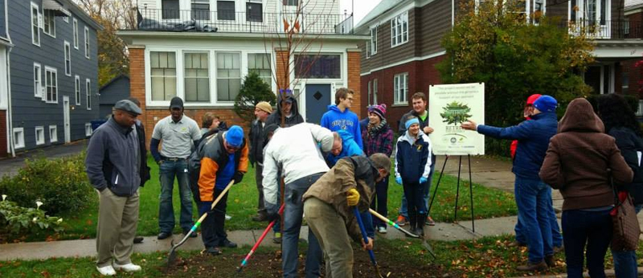

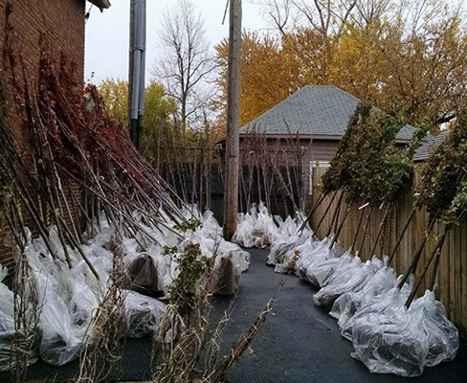
ReTree the District
One of The Tool Library’s biggest service days. Trees are planted by volunteers in parks and on residential properties. Since it’s inception in 2014, over 1,500 trees have been planted!

Slide 7
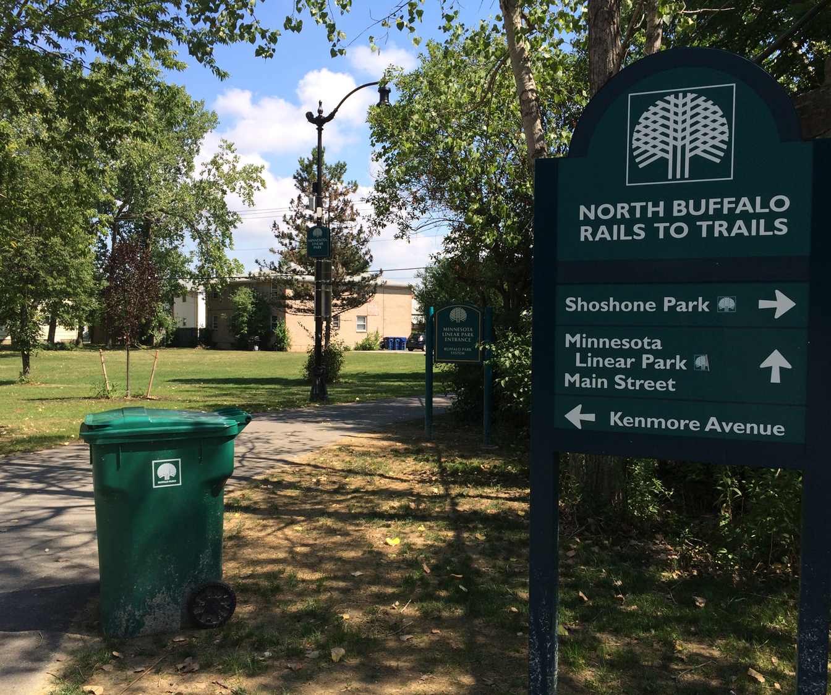
Linear Park
Created in an unused rail right of way, Linear Park is a great story of community organization and transformation of unused space. Be sure to check out the public art on the train abutments!
.

Slide 8
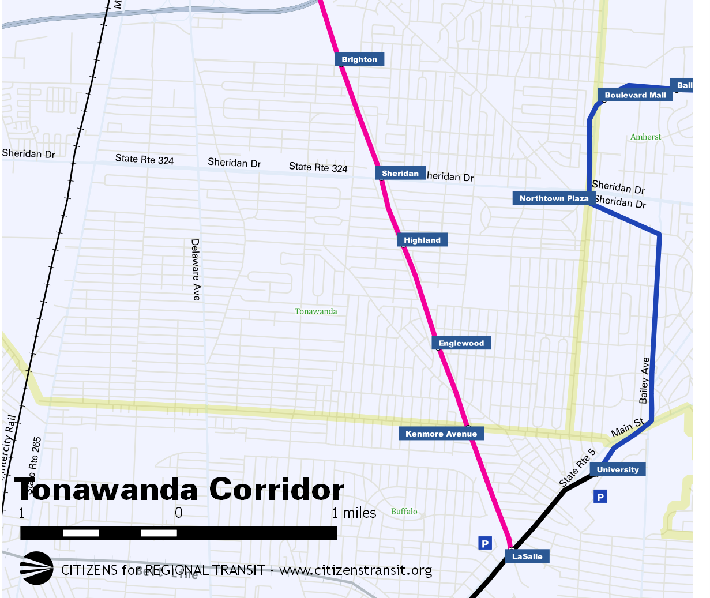
Linear Park
Linear Park plugs into a larger regional network of trails stretching all the way through Tonawanda.

Slide 9
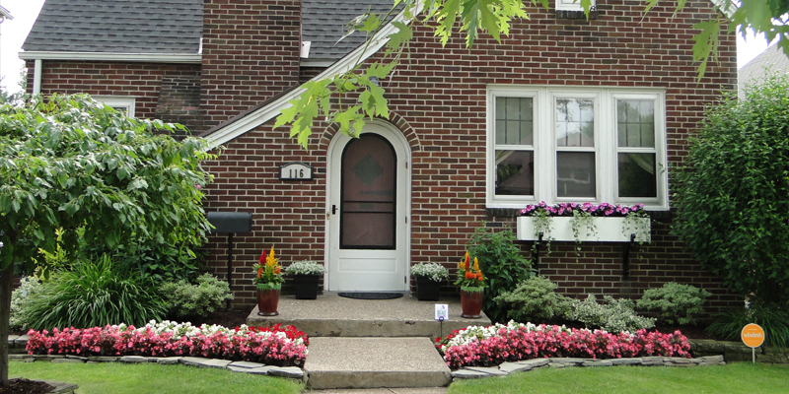

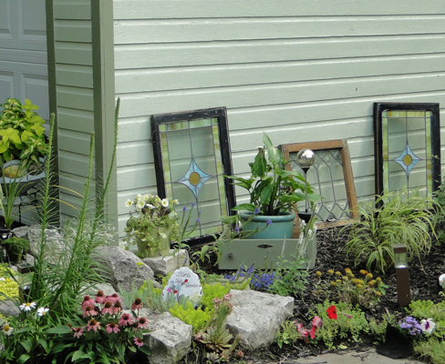
Capen Garden Walk
the
This perennial self-guided tour takes participants to the beautiful home gardens in the district. Each summer it draws hundreds of people from all over the region to the neighborhood.

Slide 10
Businesses in the Heights
There are a number of great businesses to explore in the University Heights.

Slide 11
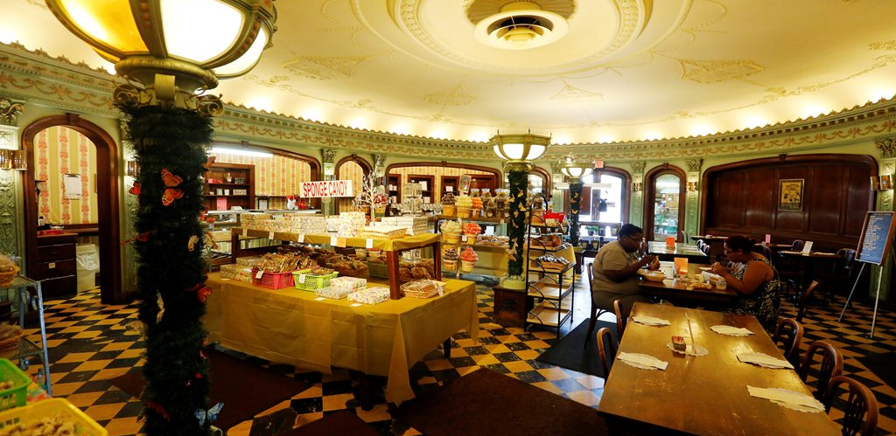
Full-width Photo
Recently restored Parkside Candies has been in business since 1927.

Slide 12
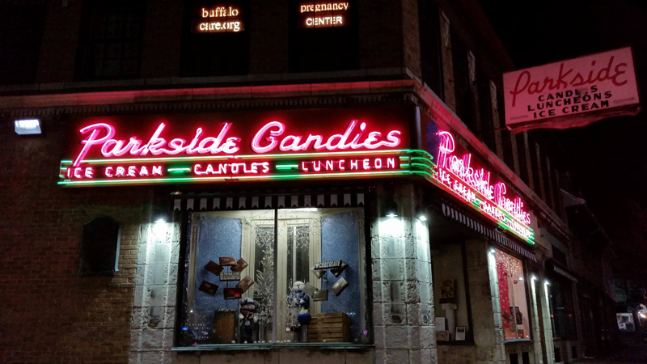
Parkside Candy Grant
Through the New York State Main Street grant program, Parkside Candies was awarded $125,000 to fund the restoration of its building. The interior, façade, and neon marquee have been refurbished and updated for efficiency.
The program is managed and implemented to preserve local architectural and cultural history at sites all over New York State, and highlights the historical importance of the neighborhood.

Slide 13
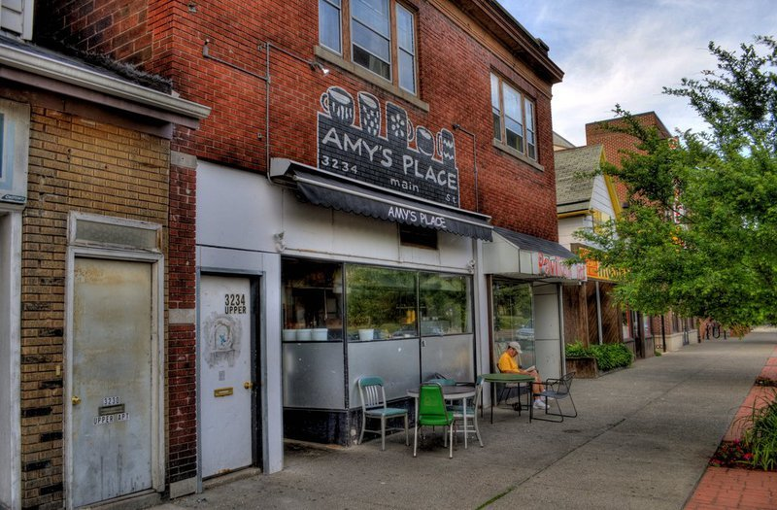
Amy’s Place
Local Lebanese and American restaurant Amy’s place has been a Main Street institution since 1981. Check out the vegan options, featured art from local artists, and early-bird breakfasts that have kept the University District fed for almost 40 years!

Slide 14
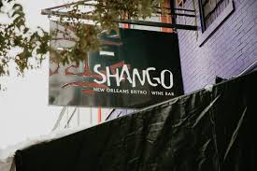
Shango
New Orleans Bistro and Wine Bar Shango has some of the most interesting southern and Cajun flavors. While more of a fine dining atmosphere exists here, they run Wednesday tasting menus for $20

Slide 15

Sato Ramen
One of the best lunch spots in the area, Sato Ramen has many different ramen flavors and other Japanese inspired dishes to try.

Slide 16
And More
Local Caribbean spots Kalypso and Dr. Birds as well as Indian buffet Tandoori Hut have bring dynamic and delicious flavors to the area!
Wholly Crepe and Lake Effect Dinner bring more breakfast options to the table as well!

Slide 17
In the News
Takeout options amidst closures: https://buffalonews.com/2020/04/20/signs-of-life-in-university-district-restaurants-old-and-new/
Local tourism highlights: https://www.visitbuffaloniagara.com/neighborhood/university-heights/
UB’s off campus art gallery: https://stepoutbuffalo.com/locations/ub-anderson-gallery/

Slide 18
Community Groups
University Heights has active block clubs on most streets as well as community gardens and longstanding events that draw people into the neighborhood.
http://ourheights.org
http://ourheights.org/gardenwalk/
http://ourheights.org/tylerstreetgarden/
Thetoollibrary.org

Slide 19
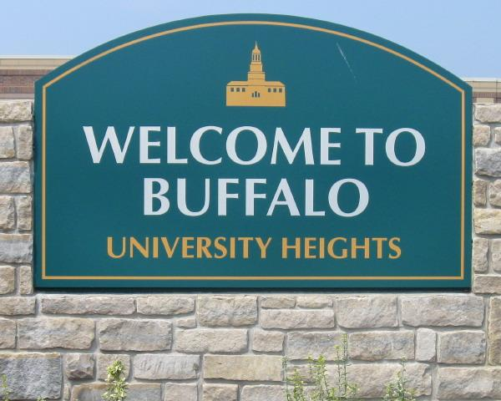
Takeaways
University Heights is a full time neighborhood where people of all ages live, work and do business. Be great neighbors and respect the community UB has called home for a century.

Slide 20
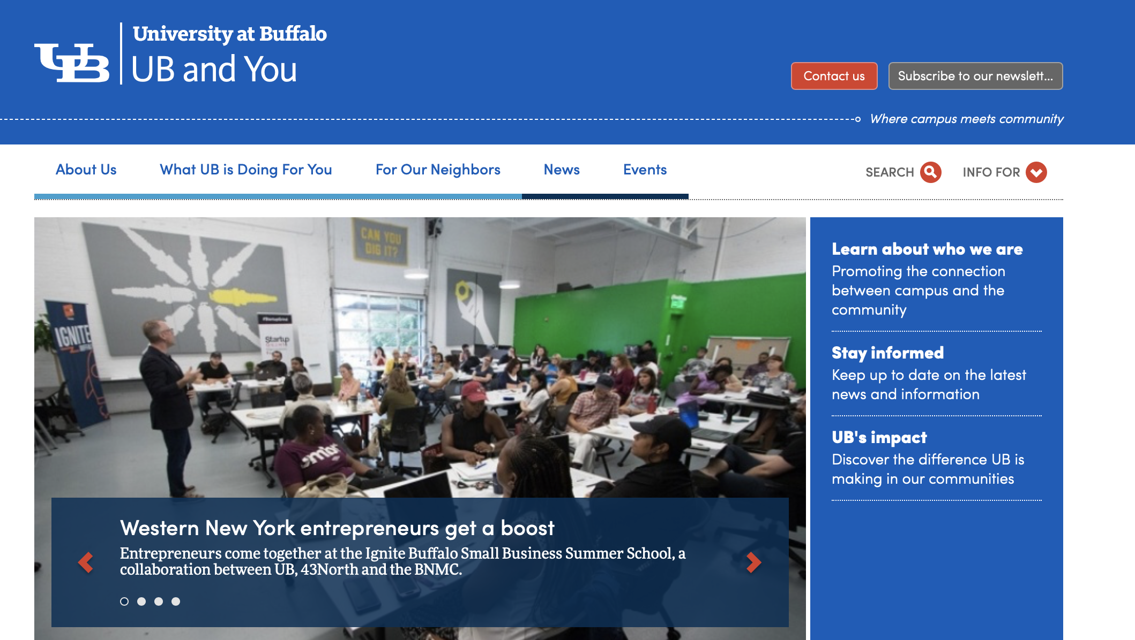
Stay Informed
For ways in which UB and the community interact check our website: buffalo.edu/community

Slide 21
Thank you
Please do not forget to complete reflection questions

